Slide 1
Introduction to Physics 1.1: Physics and the Scientific Method 1.2: Physics and Society 1.3: Units and Dimensions 1.4: Basic Math for Physics 1.5: Problem Solving in Physics

Slide 2
1.1: Physics and the Scientific Method
Learning Targets:
Describe the scientific process that is followed when determining the validity of a hypothesis.

Slide 3
Chapter 1 Introduction to Physics
Make sure you study all the vocabulary from this chapter.
There will be a vocabulary quiz at the end of the chapter.
All the vocabulary terms (30) are listed on the first page of each section.

Slide 4
1.1: Physics and the Scientific Method
Physics is a study of the fundamental laws of nature. In fact, everything in nature—from atoms and subatomic particles to solar systems and galaxies—obeys the laws of physics.
The goal of physics is to gain a deeper understanding of the world in which we live.

Slide 5
Physics and the Scientific Method
Physics is one of many natural sciences. Others include chemistry, biology, and geology.
Science is an organized way of thinking about nature and understanding how it works. Thus science is a process—it is not a thing, or an object, or just a collection of facts.
Scientists attempt to find explanations for knowledge that has been gained about natural events.

Slide 6
Physics and the Scientific Method
The systematic approach scientists use to learn about the laws of nature is referred to as the scientific method.
The scientific method has certain steps that are taken when conducting a scientific study. These steps are as follows:
Observe
Infer and Hypothesize
Test
Conclude

Slide 7
Physics and the Scientific Method
The starting point of any scientific investigation is careful observation, in which you describe events in a logical and orderly way. It is also important to be creative in your observations, seeing things as no one else has before.
Observations lead to inference and hypothesis. An inference is a logical interpretation of your observations. A hypothesis is a detailed scientific explanation for a set of observations that can be verified or rejected by experiments.

Slide 8
Physics and the Scientific Method
A useful hypothesis makes predictions that can be tested with experiments. If an experiment verifies a prediction, the hypothesis gains support. If an experiment disagrees with a prediction, the hypothesis must be rejected or modified.
Significant breakthroughs in science often start off as a hypothesis that seems to go against intuition. For example, most people thought Galileo was wrong when he said heavy objects fall at the same rate as light objects. He was right, however, as he knew from his own careful experiments.

Slide 9
Physics and the Scientific Method
A scientific theory is a detailed explanation of some aspect of nature that accounts for a set of well-tested hypotheses.
In general, theories are well-supported explanations of nature. An example is the theory of gravity, which explains why objects fall with constant acceleration on Earth's surface.
On the other hand, laws of nature—like the law of the conservation of energy—are well supported descriptions of nature.

Slide 10
Physics and the Scientific Method
If new observations disagree with a theory, the theory has to be discarded or revised. It's exciting when this happens, because it usually signals a profound breakthrough in science.
In general, a scientific law is the description of an observed phenomenon. It doesn’t explain why the phenomenon exists or what causes it. The explanation of the phenomenon is called a scientific theory. It is a misconception that theories turn into laws.

Slide 11
1.2: Physics and Society
Learning Targets:
Explain why the metric system is important in science.

Slide 12
1.2: Physics and Society
Remember to be doing your vocabulary terms.
Modern society runs on developments in science and technology, and more breakthroughs are coming all the time.
A scientific discovery gives added insight into nature. But knowing how something works isn't the same as knowing how best to use that knowledge. That is something scientists, politicians, and an informed public must decide together.

Slide 13
Physics and Society
In making the decisions that affect society, people need to avoid bias. A bias is a preference for a particular point of view for personal rather than logical or scientific reasons.
Because scientists are human, too, they can be affected by bias as much as politicians, business leaders, and others.
That's why it's important that the general public be educated about the various aspects of modern science so that they can see through biases and make informed decisions.

Slide 14
Physics and Society
A scientific research project can last months or even years. Once it is complete, the next step is to publish the results to make them known to the scientific community.
Respected scientific journals don't publish every report or paper that is submitted to them. Before a report can be published, it must undergo peer review. Peer review means that a report is sent to several experts in the field so that they can look for errors, biases, and oversights. Only after being recommended for publication by these experts can the report be published.

Slide 15
Physics and Society
Science and technology are an important part of modern society. New technologies depend on scientific advances, some of which occur years or even decades before the practical applications.
For example, Einstein's theory of relativity predicts that moving clocks run slower than clocks at rest. Decades later, the Global Positioning System (GPS) was developed. To make the GPS system work, it is necessary to take into account the relativistic slowing down of moving clocks.

Slide 16
Physics and Society
An important part of science is the ability of scientists in different locations to reproduce an experiment and verify that the reported results are consistent.
To aid in collaboration and verification, scientists have developed a system of measurement referred to as the metric system. Scientists throughout the world use this system when collecting data and performing experiments.

Slide 17
Physics and Society
The number one priority in any physics experiment is safety.
Before you start a laboratory exercise, be sure to read all the steps and make sure that you understand the entire procedure.
Following your teacher's instructions and the directions in this book is the most important safety rule of all.

Slide 18
Physics and Society
Theoretical physics is a branch of physics that employs mathematical models and abstractions of physical objects and systems to rationalize, explain and predict natural phenomena.
This is the physics we will be doing in this course. We will explain natural occurrences using mathematical equations and processes.

Slide 19
1.1 and 1.2 Assignment
Do the worksheet from your homework from sections 1.1 and 1.2.
Remember to be looking at the vocabulary terms for chapter 1.

Slide 20
1.3: Units and Dimensions
Learning Targets:
Identify the base units for different physical quantities.
List common prefixes and describe how they are used to modify base units.
Define dimensional consistency and demonstrate how it applies to physics equations.

Slide 21
1.3: Units and Dimensions
Meaningful experimental results require careful measurements of quantities such as length, mass, and time. Physicists have worked hard to develop accurate and repeatable ways to make these measurements.
Measurements involve units. The standard "measuring stick" for a physical quantity is referred to as its base unit.
The base unit of length is the meter (abbreviated m). The base units of time and mass are the second (abbreviated s) and the kilogram (abbreviated kg), respectively.

Slide 22
Units and Dimensions
The detailed system of units used by scientists was established in 1960 at the Eleventh General Conference of Weights and Measures in Paris, France. The system goes by the name Système International d'Unités, or SI for short.
When we refer to SI units we mean base units of meters (m), kilograms (kg), and seconds (s). Taking the first letter of each of these units gives a common alternate name—the mks system.

Slide 23
Units and Dimensions
The units of length have become more precise over the centuries. For example, in 1793 the French Academy of Sciences defined the meter to be one ten-millionth of the distance from the North Pole to the equator.
Since 1983 we have used a definition of a meter based on the speed of light in a vacuum. One meter is defined to be the distance traveled by light in a vacuum in 1/1,299,792,458 of a second.
For comparison purposes, a meter is about 3.28 feet. This is roughly 10% longer than a yard.

Slide 24
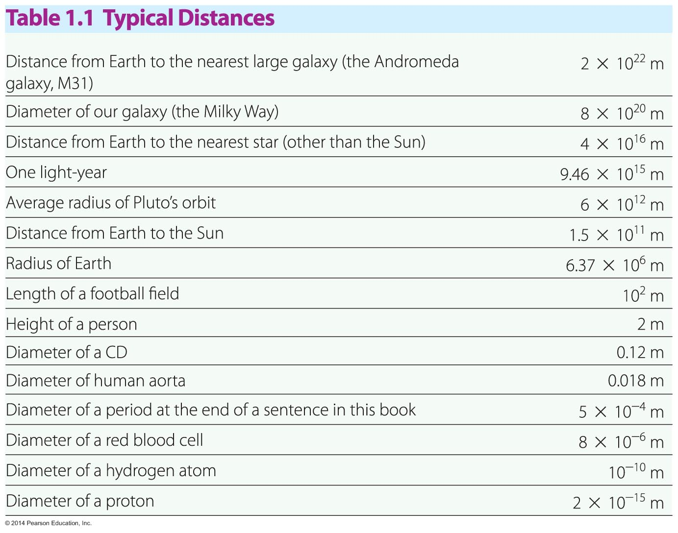
Units and Dimensions

Slide 25
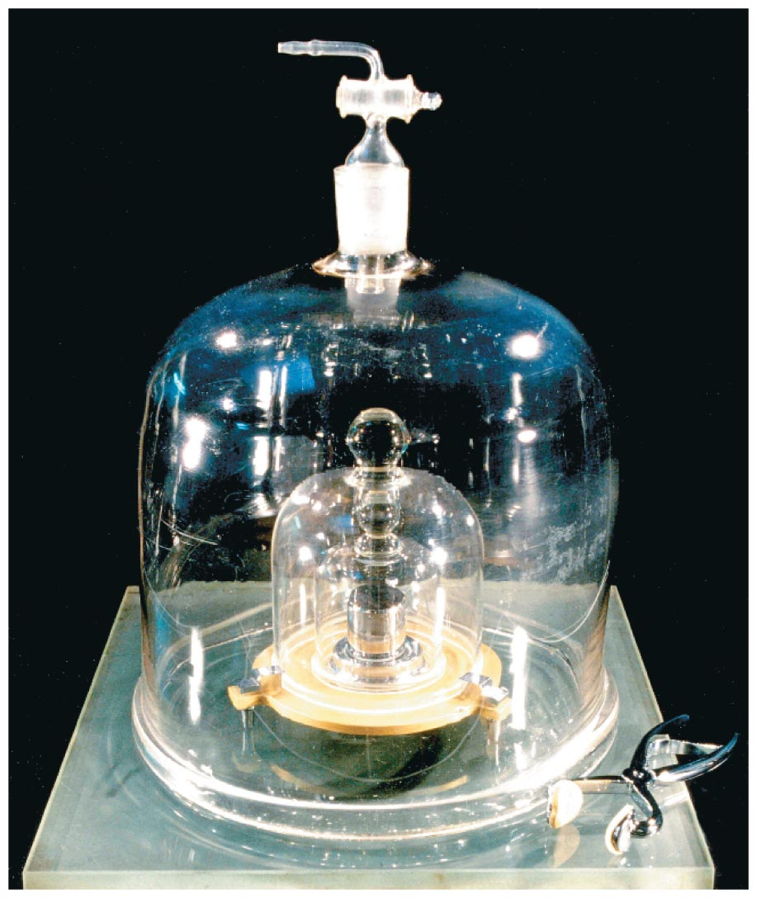
Units and Dimensions
Mass is the measure of the amount of matter in an object. It is measured in units defined by a platinum-iridium cylinder at the International Bureau of Weights and Measures in Sèvres, France. This cylinder, known as the standard mass, is shown in the figure below.
The cylinder is kept under two glass bell jars to prevent even a speck of dust from landing on it and changing its mass.

Slide 26
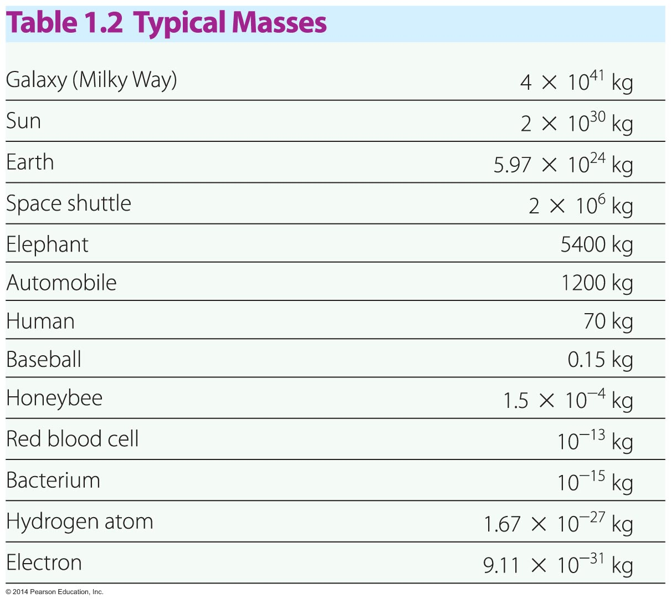
Units and Dimensions
In SI units, mass is measured in kilograms.
To put the kilogram in everyday terms, a quart of milk has a mass slightly less than 1 kilogram.
The following table gives a list of typical masses.

Slide 27
Units and Dimensions
Weight and mass are quite different quantities.
Mass is an intrinsic, unchanging property of an object.
Weight, in contrast, is a measure of the gravitational force acting on an object and varies depending on the object's location.

Slide 28
Units and Dimensions
Nature has provided us with a fairly accurate timepiece in the revolving Earth. Prior to 1965, the mean solar day was defined to consist of 84,400 seconds (23.4 hours). Even the rotation of the Earth is not completely regular, however.
Today, time is measured in units based on the operation of atomic clocks, the world's most accurate timepieces.

Slide 29
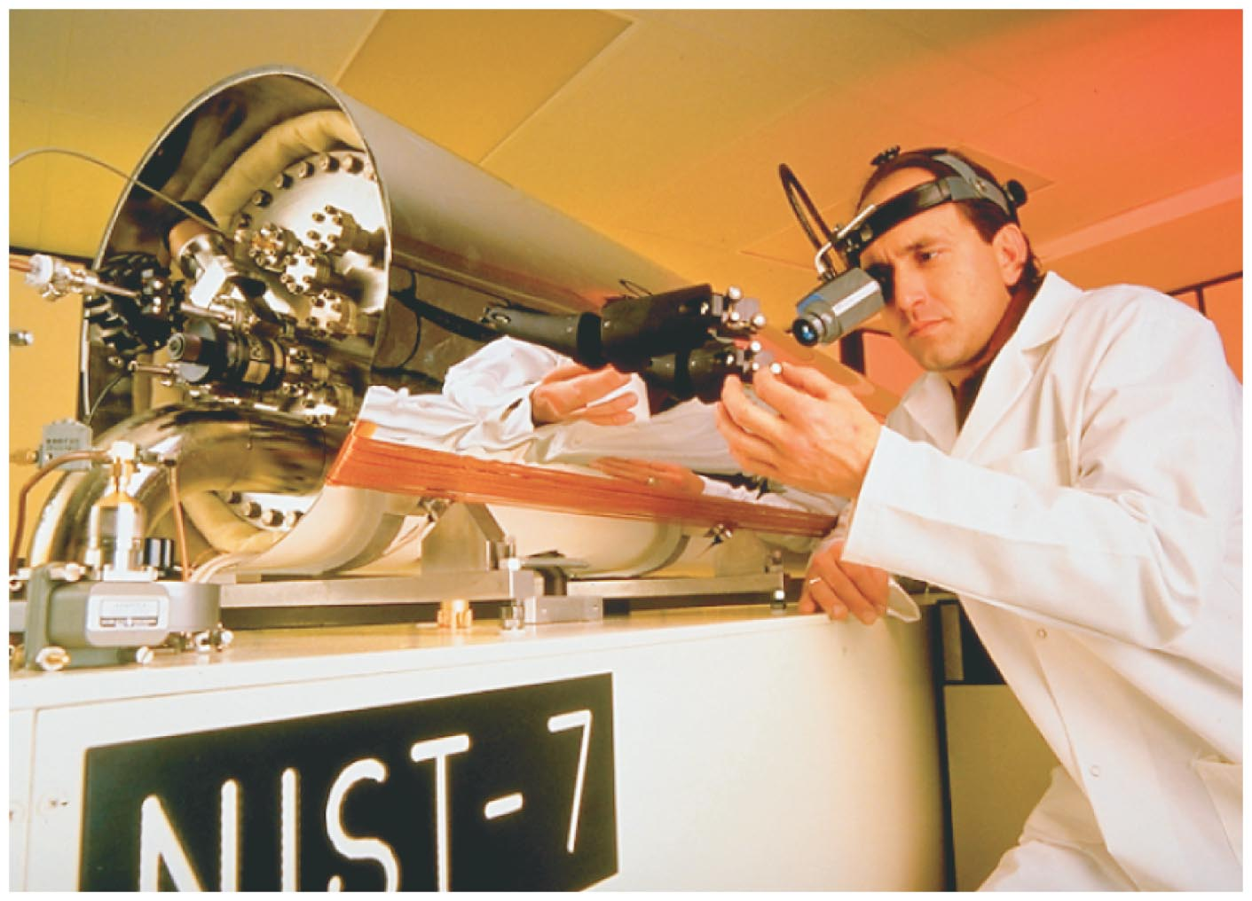
Units and Dimensions
The atomic clock shown in the figure below keeps time on the basis of radiation from cesium atoms. It is accurate to about three millionths of a second per year.
Based on the operation of an atomic clock, 1 second is defined as the time it takes for radiation from a cesium-133 atom to oscillate 9,192,631,770 times.

Slide 30
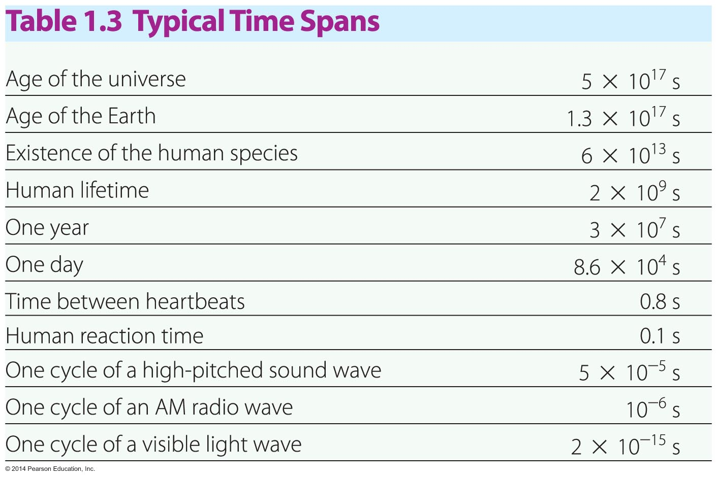
Units and Dimensions
A range of typical time intervals appears in the table below.

Slide 31
Units and Dimensions
Prefixes are used to designate common multiples the SI basic units in powers of 10.
For example, prefix kilo (abbreviated k) means one thousand, or equivalently 10³. Thus, 1 kilogram is the same as 1000 grams or 10³ grams.
1 kg =10³ grams
Similarly, the prefix milli (abbreviated m) means one thousandth, or 10⁻³. Thus, 1 millimeter (mm) is the same as 0.001 m, or 10⁻³ meter.
1 mm = 10⁻³ m

Slide 32
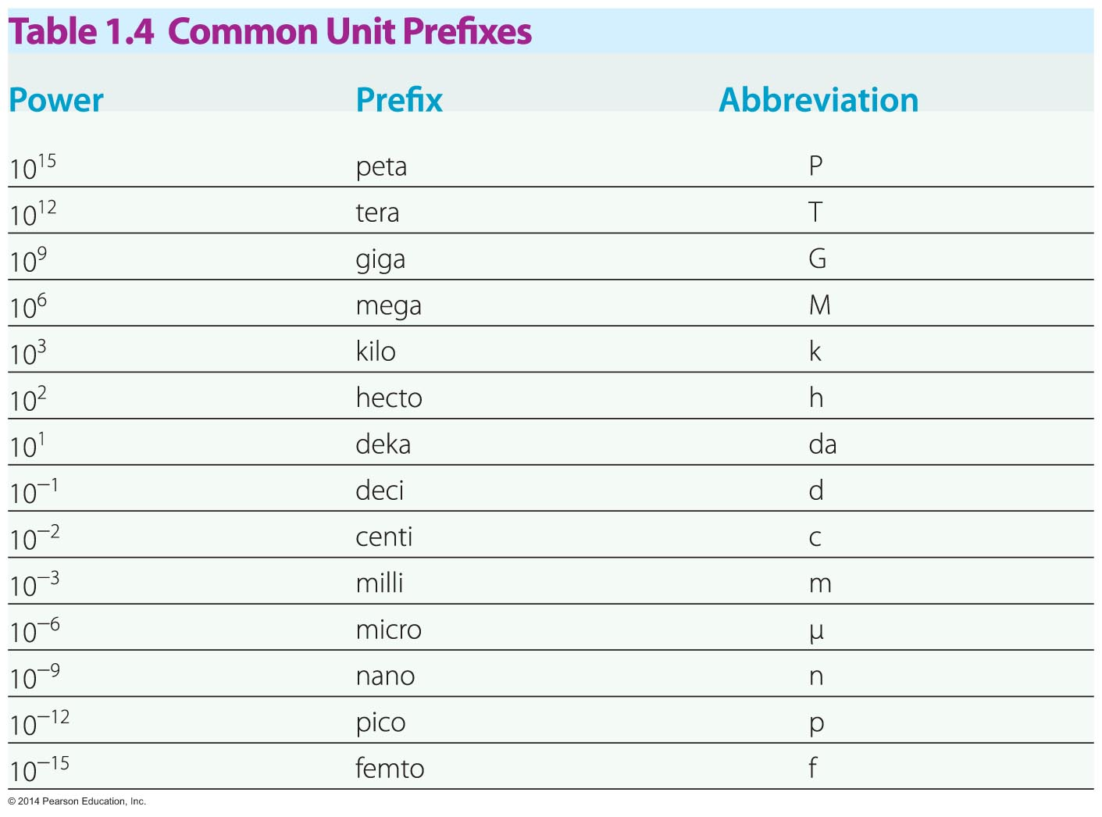
Units and Dimensions
The most common unit prefixes are listed in the table below.

Slide 34
Units and Dimensions
The dimension of a physical quantity refers to the type of quantity it is, regardless of the units used in the measurement.
For example, consider the two distance measurements of 25 km and 1.25 cm. Though each has a different unit, they both have the same dimension—length.
As will be shown, the dimensions found in an equation lead to useful techniques for verifying a solution and for converting from type of unit to another.

Slide 35
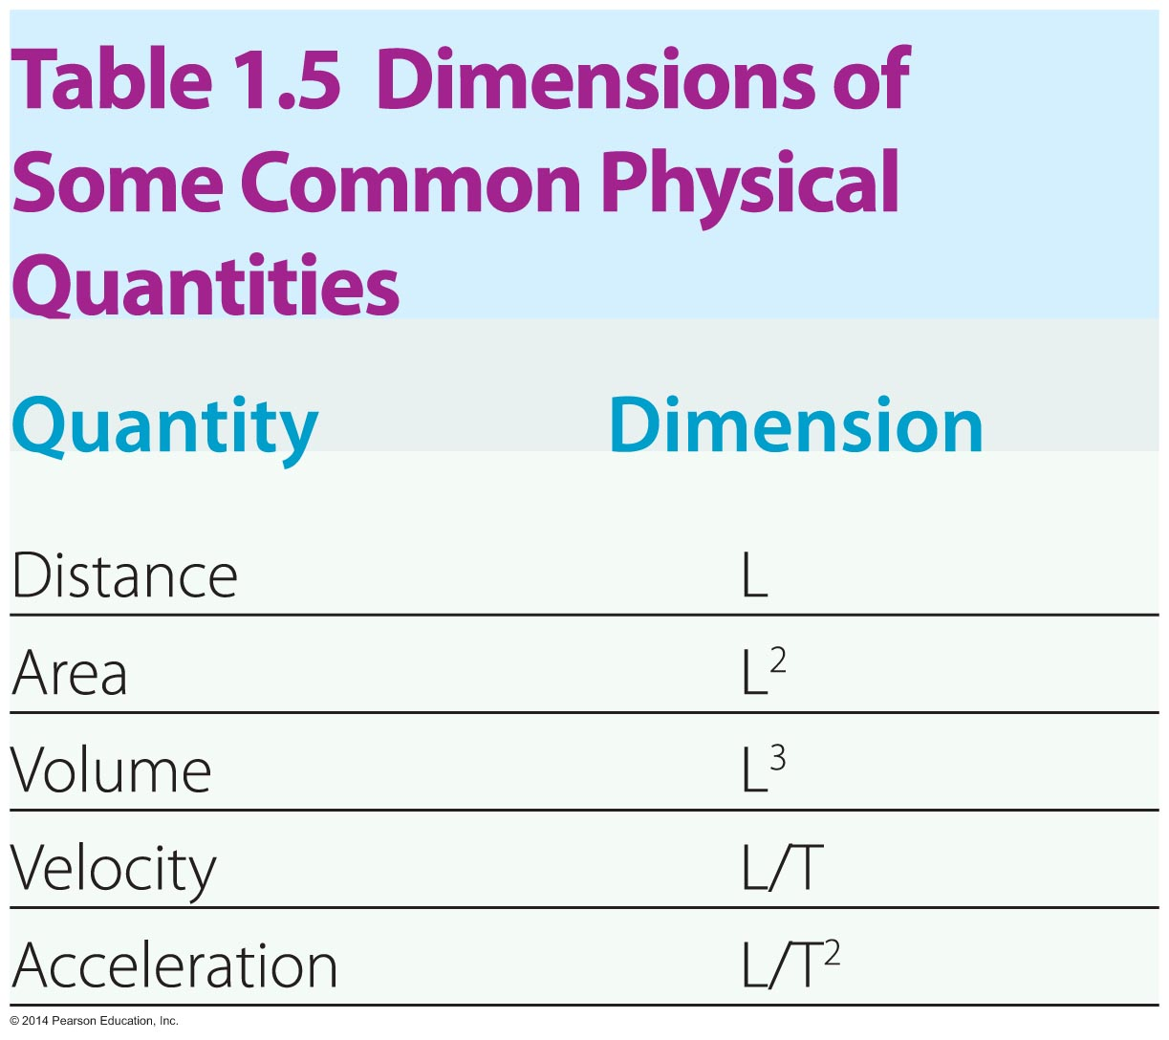
Units and Dimensions
The table below gives the dimensions of some common physical quantities.

Slide 36
Units and Dimensions
Unit dimensions need to be exactly the same when adding and subtracting.
You cannot add seconds and meters
Unit dimensions can differ when multiplying and dividing.
Distance is distance/time.
m/s

Slide 37
Units and Dimensions
Any valid equation in physics must be dimensionally consistent. This means that each term in a physics equation must have the same dimensions. If a physics equation isn’t dimensionally consistent, it isn’t correct.
As an example, let's check the dimensions of the equation x_{f} = x_{i} + vt. In this equation, x_{f} and x_{i} represent lengths, v is velocity (length/time), and t is time. Writing out the dimensions in each term, we have
length = length + (length/time) (time)
Cancelling out the time yields
length = length = length

Slide 38
Units and Dimensions
This type of calculation—one written in terms of dimensions—is referred to as dimensional analysis.
Occasionally, you might need to convert from a non-SI unit to an SI unit.
For example, suppose you would like to convert 316 ft to its equivalent in meters. Looking at the conversion factors on the inside cover of the text, you find 1 m = 3.28 ft. Equivalently,
1 m/3.28 ft = 1
To make the conversion, simply multiply 316 ft by this expression, which is equivalent to multiplying by 1:
316 ft(1 m/3.28 ft) = 96.3 m

Slide 39
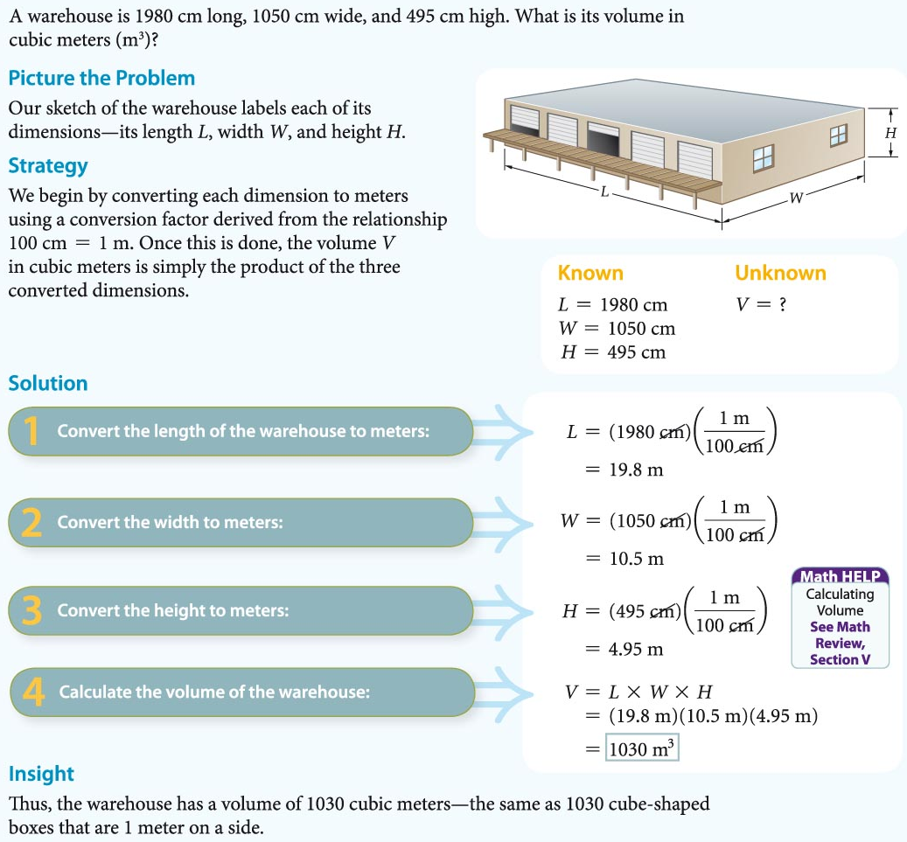

Slide 40
Notes:
1.26 km/h

Slide 41
1.4: Basic Math for Physics
Learning Targets:
Define physical quantities and list several examples.
Demonstrate understanding of significant figures when making measurements and evaluating arithmetic expressions.
Explain the main reason for using scientific notation.
Distinguish between vector quantities and scalar quantities.

Slide 42
1.4: Basic Math for Physics
Mathematics is the language of physics. Much of physics is expressed elegantly in simple equations.
In general, an equation is a mathematical expression that relates physics quantities. A physical quantity is a property of a physical system that can be measured, like length, speed, acceleration, or time duration.

Slide 43
Basic Math for Physics
For example, consider the equation for calculating the speed of an object. As you may know, the speed of an object is the distance covered divided by the time required to cover it.
Instead of writing out the full statement "speed is equal to distance divided by time" we can write v = d/t where v is the speed, d the distance, and t the time.

Slide 44
Basic Math for Physics
Any equation can be rearranged to give information about any of the physical quantities in it.
For example, suppose you want to find the distance traveled by an object moving with a certain speed for a certain period of time. To do this, you simply solve the basic equation v = d/t for the distance (d).
Starting with the basic equation v = d/t, multiply both sides of the equation by t:
v x t = d/t x t
Cancelling out the t's on the right side of the equation gives v x t = d or d = v x t.

Slide 45
Basic Math for Physics
Making accurate measurements in the laboratory and accurately expressing calculated results are important skills.
When a mass, length, or time is measured in a scientific experiment, the result is always subject to some uncertainty. This inaccuracy, or uncertainty, can be caused by a number of factors:
limitations in a measuring device,
limitations in human perception, and
limitations in the skill of the experimenter.

Slide 46
Basic Math for Physics
The quality of a scientific measurement is determined by two different characteristics.
The first is accuracy, which is a measure of how close the measured value is to the actual value.
The second is precision, which is a measure of how close together the values of a series of measurements are to one another.
The figure in the next slide illustrates the differences between situations where accuracy and precision are either good or poor.

Slide 47
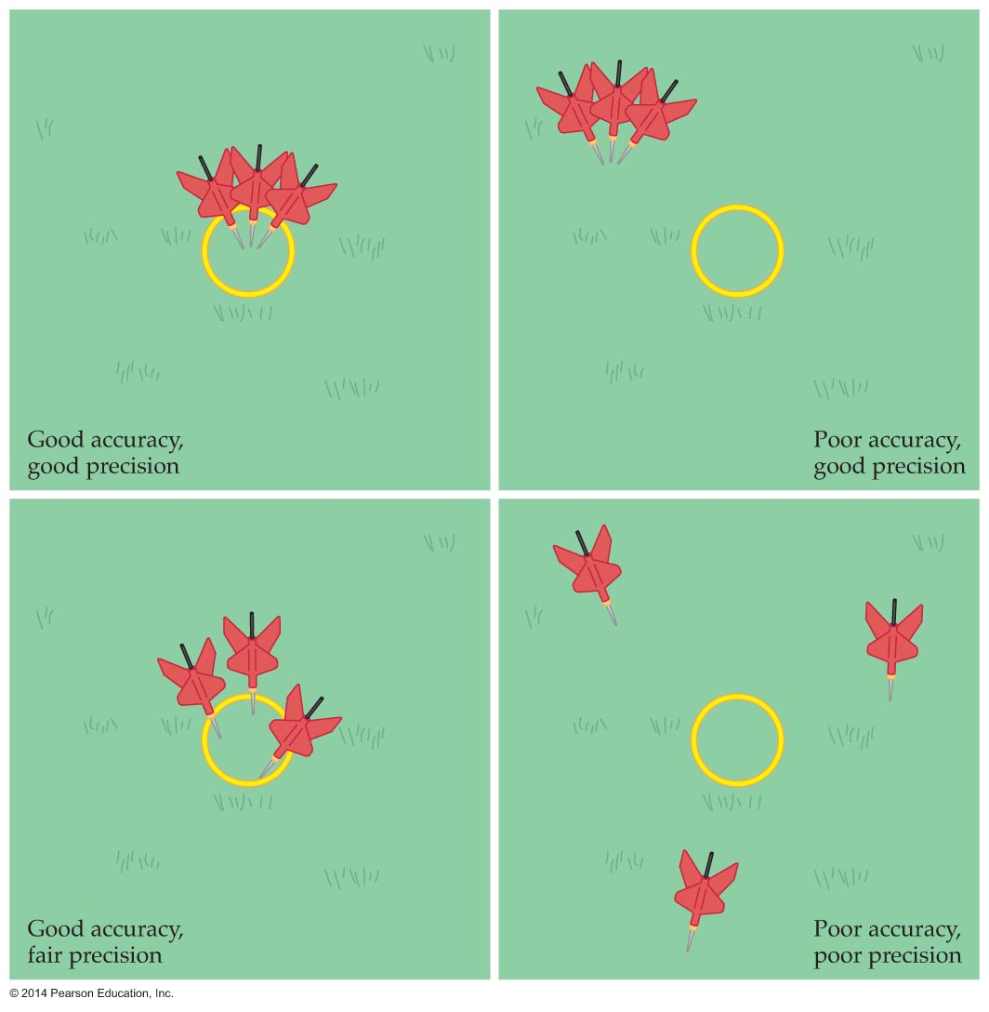
The figure below shows the results of three tosses in a game of lawn darts. Darts within the circle represent good accuracy; darts closely packed together represent good precision.

Slide 48
Basic Math for Physics
Suppose you measure a distance using a ruler and find that the distance is just over 21 cm. You estimate that the amount over 21 cm is about 0.2 cm, so your best estimate of the distance is 21.2 cm. We say that the measured distance of 21.2 cm contains three significant figures.
The number of significant figures in a measurement is defined to be the number of digits that are actually measured plus one estimated digit.

Slide 49
Basic Math for Physics
How many significant figures in the following?
23
200
200.
3.27
0.00000045
5.0000000
2000004

Slide 50
Basic Math for Physics
When multiplying or dividing numbers, the number of significant figures in the answer is the same as the number of significant figures in the least accurately known input value.
For example, let's say that an object moves 21.2 cm in 8.5 s. We know the distance to three significant figures and the time to two significant figures. As a result, when we calculate the speed of the object, there should only be two significant figures in the answer:
v = d/t = 21.2 cm/8.5 s = 2.5 cm/s

Slide 52
Basic Math for Physics
In the product A * B * C, A has 3 sig figs, B has 2 sig figs, and
C has 4 sig figs. How many sig figs would the product have?
In the quotient (A*B) / C, A has 4 sig figs, B has 1 sig figs, and
C has 6 sig figs. How many sig figs would the quotient have?

Slide 53
Basic Math for Physics
When we add or subtract numerical values, we use a slightly different rule to determine the number of significant figures in the answer.
The number of decimal places in a result from addition or subtraction is equal to the smallest number of decimal places in any of the input values.
For example, if you make a time measurement of 16.74 s, and then make a second time measurement of 5.1 s, the total time of the two measurements must have just one decimal place. Therefore, the correct answer is 21.8 s, not 21.84 s.

Slide 54
Basic Math for Physics
In the sum A + B + C, A is accurate to 3 decimal places, B is accurate to 4 decimal places, and C is accurate to 5 decimal places. What is the correct number of decimal places in the sum?
In the difference A - B - C, A is accurate to 0 decimal places, B is accurate to 4 decimal places, and C is accurate to 7 decimal places. What is the correct number of decimal places in the difference?

Slide 56
Basic Math for Physics
Scientific notation expresses a value as a number between 1 and 10 times an appropriate power of 10. It is very useful, for it clearly specifies the number of significant figures.
Consider the number 2500. It is unclear whether the two zeros are significant. Perhaps they simply indicate the location of the decimal point.
In this example, we express the distance 2500 m as 2.5 x 10³ if there two significant figures, or as 2.500 x 10³ if there are four significant figures, thus eliminating ambiguity.

Slide 58
Basic Math for Physics
An order-of-magnitude calculation is a rough estimate designed to be accurate within the nearest power of 10. Such a ballpark estimate gives you a quick idea of the order of magnitude to expect from a complete, detailed calculation.
For example, suppose you want to estimate the speed of a cliff diver on entering the water. First, the cliff may be about 10 m high—certainly not 1 m or 10² m. Next, the diver hits the water something like a second later—certainly not 0.1 s later or 10 seconds later. Thus a reasonable order-of-magnitude estimate of the diver's speed is v = d/t = 10 m/1 s = 10 m/s.

Slide 59
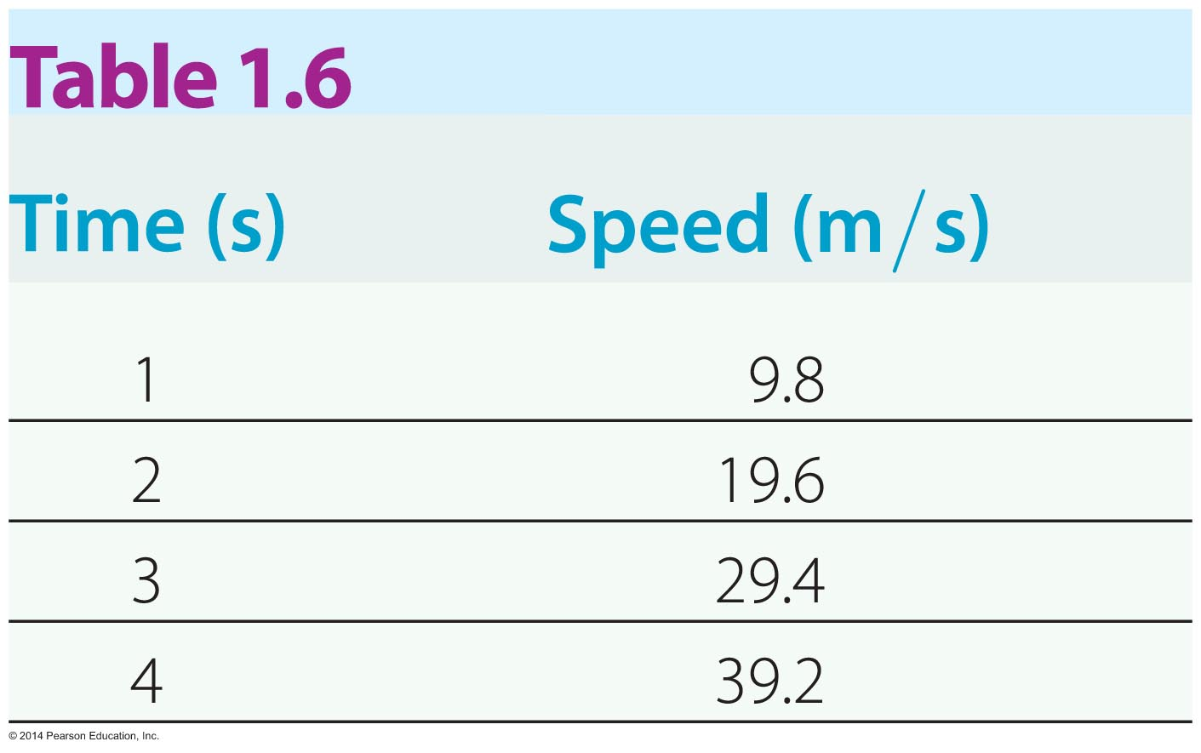
Basic Math for Physics
Graphs are useful for visualizing data. For example, suppose you measure the speed of a falling soccer ball at various times. The data collected are presented in the table below.

Slide 60
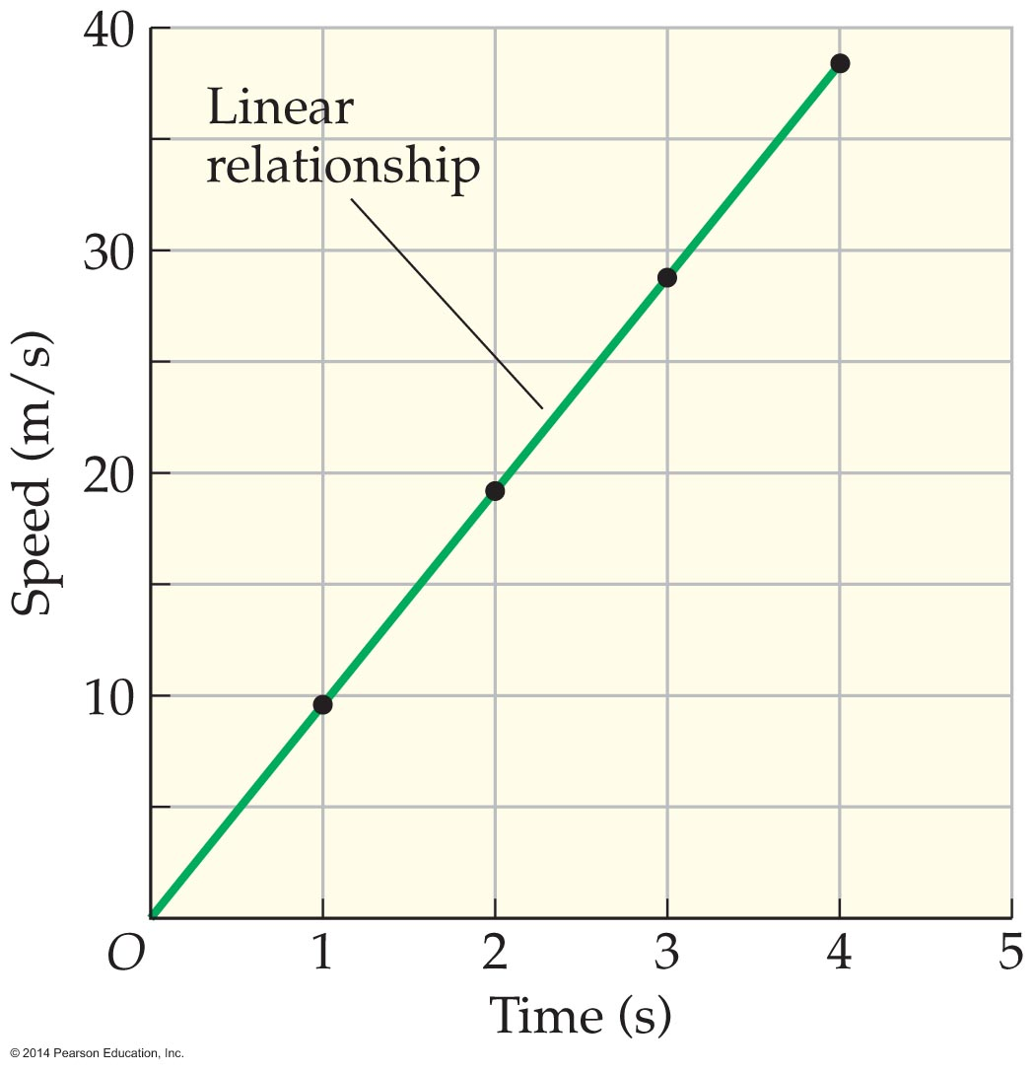
Basic Math for Physics
Graphing this data, we notice that the points lie on a straight line (see figure below). This means that the speed increases linearly with time. That is, v = (constant)t.
With this information, we can predict the speed of the soccer ball at 7 seconds, 2.5 seconds, or any other time.

Slide 61
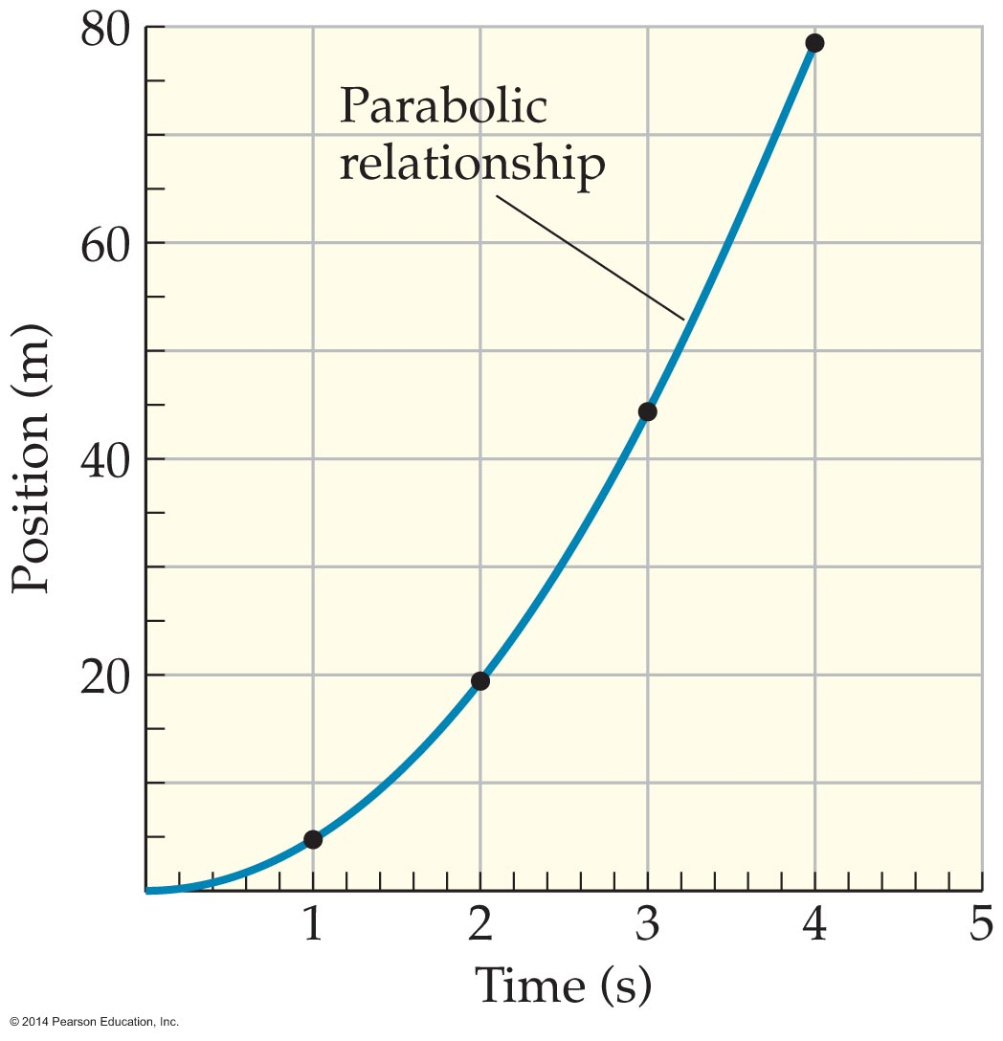
Basic Math for Physics
In general, a linear relationship exists between two quantities that form a straight line on a graph. Notice the visual impact of a graph, how it conveys so much information at just a glance—more so than a simple list or table of numbers.
Next, suppose we measure the distance covered by the soccer ball. Plotting the data taken during each second of the ball's motion gives the graph shown below.

Slide 62
Basic Math for Physics
In this case, the graph is not linear. The upward-curving shape shown on the graph is a parabola. This shape indicates that the position depends on the time squared. That is,
position = constant x time x time
x = (constant)t²

Slide 63
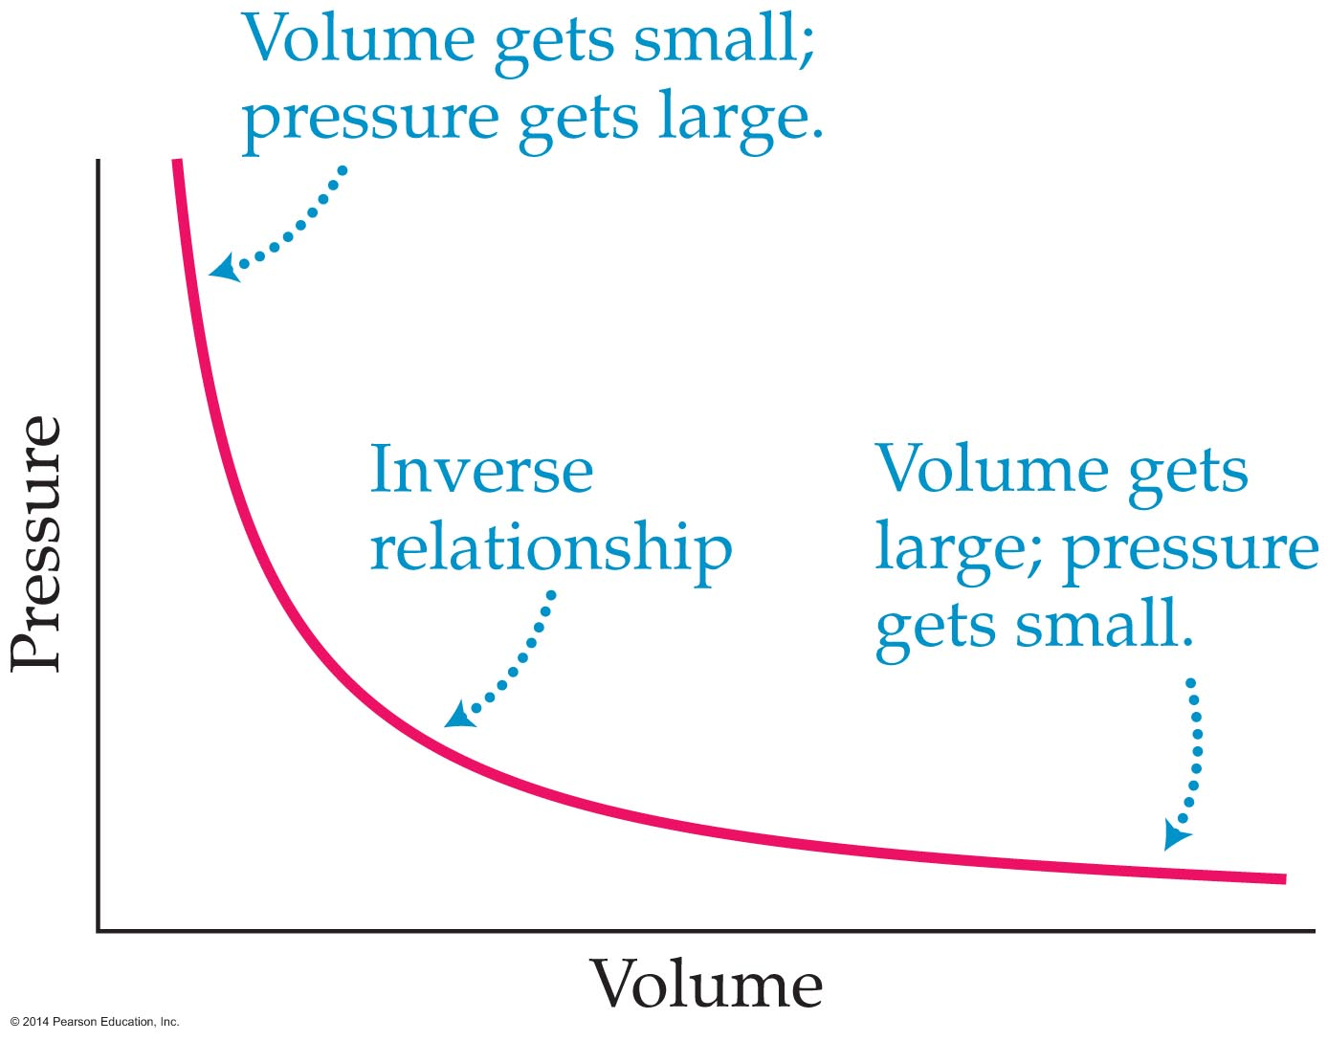
Basic Math for Physics
Finally, measurement of the volume of a container and the pressure of the gas within it gives the graph shown below.
This relationship is inverse. In an inverse relationship, as one quantity gets larger, the other gets smaller. In this case,
pressure = constant/volume.
P = constant/V

Slide 64
Basic Math for Physics
Quantities known as scalars are represented by a number with a unit.
Examples of scalars include temperature of an ice cube (−10 °C) and the speed of a car (25 m/s).
Speed is a scalar quantity that describes the rate of motion.
Other quantities, known as vectors, consist of a numerical value with its unit and a direction.
For example, when the speed of a car (25 m/s) is combined with a direction of travel (north), the result is a vector (25 m/s north).
Velocity describes the rate of motion and the direction of motion.

Slide 65
Basic Math for Physics
The key thing to remember is that vectors have both a numerical value (a magnitude) and a direction, whereas scalars have only a magnitude.

Slide 66
1.5: Problem Solving in Physics
Learning Targets:
List the general guidelines that students should follow when solving problems in physics.

Slide 67
Problem Solving in Physics
The best way to learn physics is by doing physics. Doing physics involves conducting experiments as well as solving problems.
Solving problems is a creative activity. The following suggestions, then, are not intended as a rigid set of steps that must be followed like steps in a computer program. Rather, they provide general guidelines that experienced problem solvers find to be effective.

Slide 68
Problem Solving in Physics
Read the problem carefully. Before you can solve a problem, you need to know exactly what information it gives and what it asks you to determine.
Sketch the system. A sketch helps you acquire a physical feeling for the system. It also provides an opportunity to label those quantities that are known and those are to be determined.
Visualize the physical process. Try to visualize what is happening in the system as if you were watching it in a movie. Your sketch should help.

Slide 69
Problem Solving in Physics
Strategize. From your sketch and visualization, try to identify the physical processes at work in the system. Ask yourself what concepts or principles are involved in the situation. Then develop a strategy—a game plan—for solving the problem.
Identify appropriate equations. Once you have developed a strategy, find the specific equations that are needed to carry it out.
Solve the equations. Use basic algebra to solve the equations identified in the previous step. In general, you should work with symbols (such as x or v) as much as possible, substituting numerical values near the end of the calculations.

Slide 70
Problem Solving in Physics
Check your answer. Once you have an answer, check to see if it makes sense. Does your answer have the correct dimensions? Is its numerical value reasonable and proper sig figs?
Explore limits and special cases. Getting the correct answer is nice, but it's not all there is to physics. You can learn a great deal about the connection between physics and mathematics by checking various limits of your answer. For example, if you have two masses in your system, m₁ and m₂, what happens in the special case when m₁ = 0 or m₁ = m₂?

Slide 71
1.5: Problem Solving in Physics
Vocabulary Quiz Monday. It is matching and has 30 terms.
Use this time to study for the Vocabulary Quiz or finish any assignment from chapter 1 you don’t have done.

